Slide 1

Physics 1
Voronkov Vladimir Vasilyevich

Slide 2
Lecture 11
Magnets.
Magnetic force.
The Lorentz force.
The Hall effect.

Slide 3
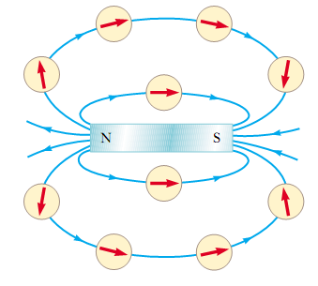
Magnets
A single magnetic pole has never been isolated. Magnetic poles are always found in pairs.
The direction of magnetic field is from the North pole to the South pole of a magnet.

Slide 4
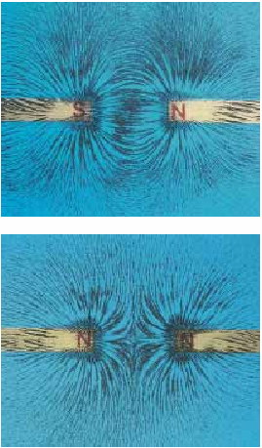
Magnet Poles
Magnet field lines connect unlike poles.
Magnet field lines repels from like poles.

Slide 5
Magnetic Force
The magnitude F_{B} of the magnetic force exerted on the particle is proportional to the charge q and to the speed v of the particle.
The magnitude and direction of F_{B} depend on the velocity of the particle and on the magnitude and direction of the magnetic field B.
When a charged particle moves parallel to the magnetic field vector, the magnetic force acting on the particle is zero.
When the particle’s velocity vector makes any angle Θ≠0 with the magnetic field, the magnetic force acts in a direction perpendicular to both v and B.
The magnetic force exerted on a positive charge is in the direction opposite the direction of the magnetic force exerted on a negative charge moving in the same direction.
The magnitude of the magnetic force exerted on the moving particle is proportional to sin Θ, where Θ is the angle the particle’s velocity vector makes with the direction of B.

Slide 6
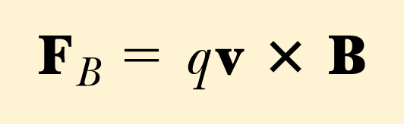
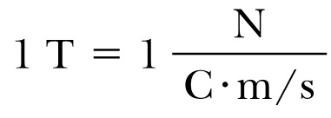
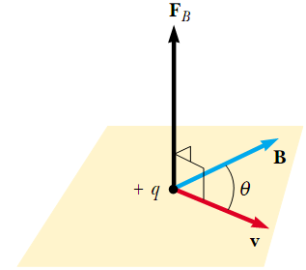
The text in the previous slide can be summarized as:
So the units for B are:
The magnetic force is perpendicular to both v and B.
F_{B}=qVBsinΘ

Slide 7
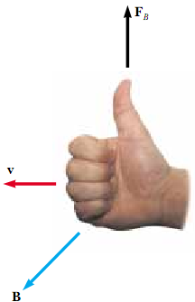

Direction of F_{B}
Right hand rule:
The fingers point in the direction of v, with B coming out of your palm, so that you can curl your fingers in the direction of B. The direction of , and the force on a positive charge, is the direction in which the thumb points.

Slide 8
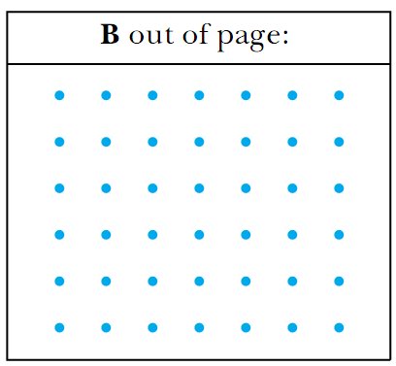
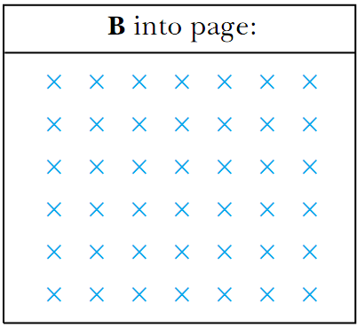
Magnetic field direction
Magnetic field lines coming out of the paper are indicated by dots, representing the tips of arrows coming outward.
Magnetic field lines going into the paper are indicated by crosses, representing the feathers of arrows going inward.

Slide 9
Magnetic Force on a Current
Magnetic force is exerted on a single charge moving in a magnetic field. A current-carrying wire also experiences a force when placed in a magnetic field. This follows from the fact that the current is a collection of many charged particles in motion; hence, the resultant force exerted by the field on the wire is the vector sum of the individual forces exerted on all the charges making up the current. The force exerted on the particles is transmitted to the wire when the particles collide with the atoms making up the wire.

Slide 10
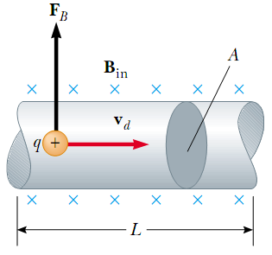

n is the number density of charged particles q
v_{d} is the drift speed of q
A – area of the segment
L – the length of the segment
Then AL is the volume of the segment, and
nAL is the number of charged particles q.
Then the net force acting on all moving charges is:

Slide 11

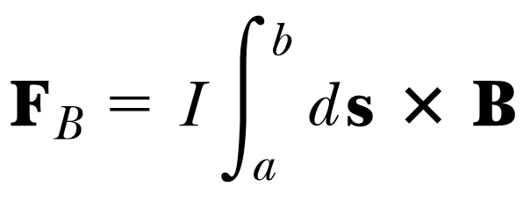
Arbitrary shaped wire
The force on a small segment of an arbitrary shaped wire is:
The total force is:
a and b are the end points of the wire.

Slide 12
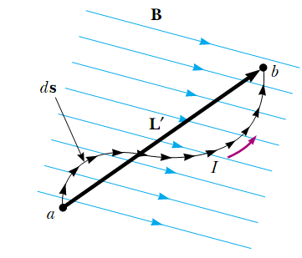
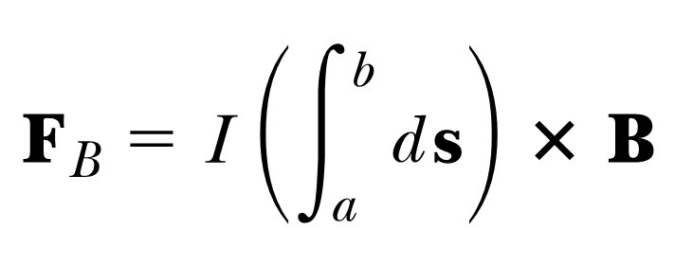

Curved Wire in a Uniform Magnetic field
as B is uniform:
The magnetic force on a curved current-carrying wire in a uniform magnetic field is equal to that on a straight wire connecting the end points and carrying the same current.

Slide 13


Magnetic force on a straight wire
So, the force on a straight wire in a uniform magnetic field is:
is a vector multiplication.
Where L is a vector that points in the direction of the current I and has a magnitude equal to the length L of the segment. This expression applies only to a straight segment of wire in a uniform magnetic ﬁeld.

Slide 14
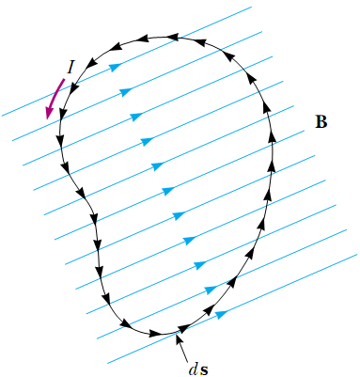
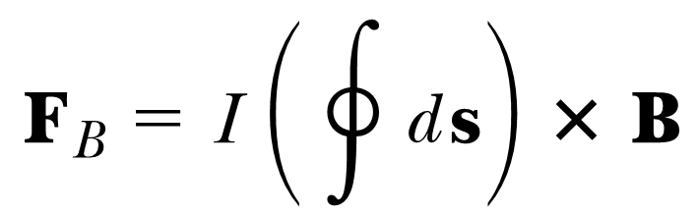
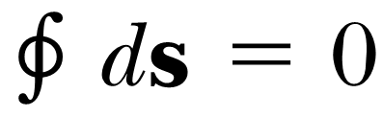
Loop Wire in a Uniform Magnetic field
The net magnetic force acting on any closed current loop in a uniform magnetic field is zero:
Then the net force is zero:
F_{B}=0

Slide 15
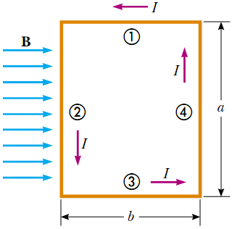
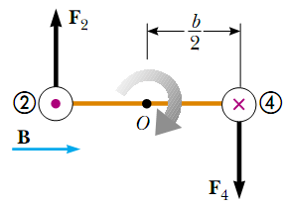
Current Loop Torque in a Uniform Magnetic Field
- Overhead view of a rectangular loop in a uniform magnetic field.
Sides 1 and 3 are parallel to magnetic field, so only sides 2 and for experiences magnetic forces.
- Magnet forces, acting on sides 2 and 4 create a torque on the loop.

Slide 16

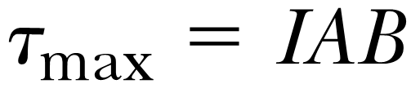
When the magnetic field is parallel to the plane of the loop, the maximal torque on the loop is:
ab is the area of the loop A:

Slide 17
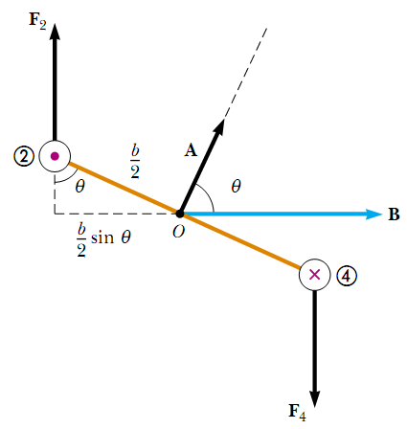

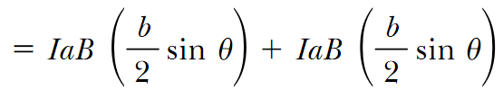


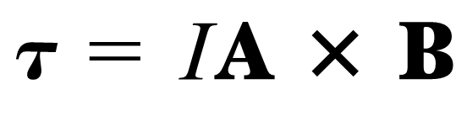
When the loop is not parallel to the magnetic field, i.e. the angle between A and B is Θ < 90° then:
So the torque on a loop in a uniform magnetic field is:
This formula is correct not only for a rectangular loop, but for a planar loop of any shape.

Slide 18
Area Vector
In formula for torque
we have vector A:
- Its direction is perpendicular to the plane of the loop,
- its magnitude is equal to the area of the loop.
We determine the direction of A using the right-hand rule. When you curl the fingers of your right hand in the direction of the current in the loop, your thumb points in the direction of A.

Slide 19
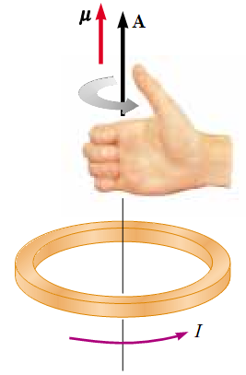
Right – hand rule for loop
The direction of the magnetic moment is the same as the direction of A.

Slide 20
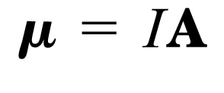
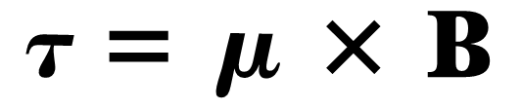
Magnetic Moment
The vector product IA is defined to be the magnetic dipole moment μ (often simply called the “magnetic moment”) of the current loop:
Then the torque on a current-carrying loop is:

Slide 21
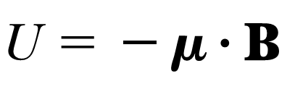


Potential Energy of a Magnetic Moment
The potential energy of a system having magnetic dipole μ in the magnetic field B is:
Here we have scalar product μ B. Then the lowest energy is when μ points as B, the highest energy is when μ points opposite B:

Slide 22
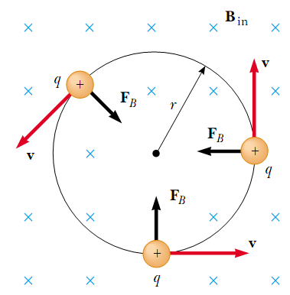
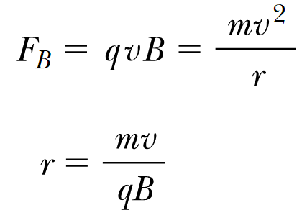
Motion of a Charged Particle in a Uniform Magnetic Field
When the velocity of a charged particle is perpendicular to a uniform magnetic field, the particle moves in a circular path in a plane perpendicular to B. The magnetic force F_{B} acting on the charge is always directed toward the center of the circle.

Slide 23
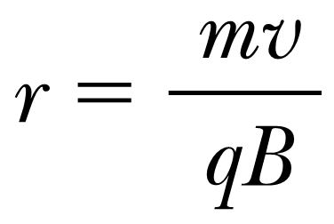
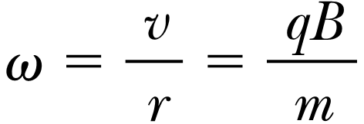
Using the obtained formula
we get the angular velocity
here v is perpendicular to B.

Slide 24

Lorentz Force
In the presence of E and B, the force acting on a charged particle is:
here q is the charge of the particle,
v – the speed of the particle,
E – electric field vector
B – magnetic field vector

Slide 25
The Hall Effect
When a current-carrying conductor is placed in a magnetic field, a potential difference is generated in a direction perpendicular to both the current and the magnetic field.

Slide 26
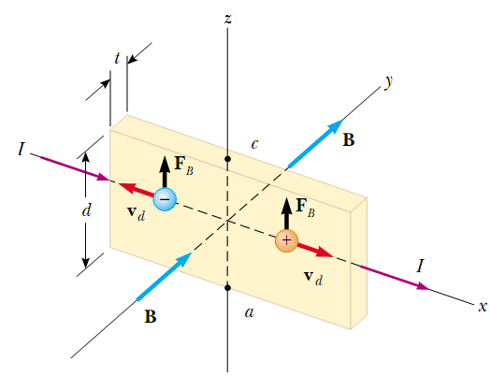
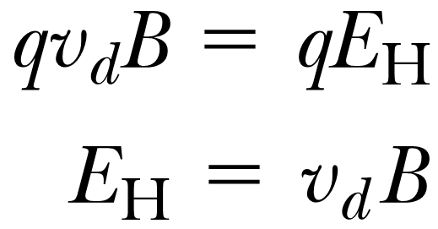

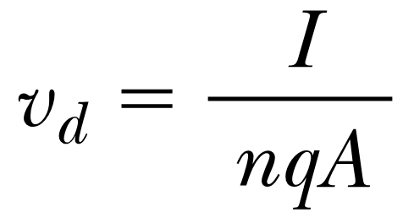
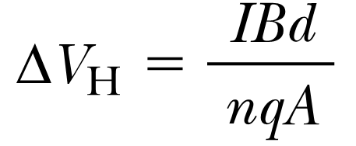
the magnetic force exerted on the carriers has magnitude qv_{d}B.
this force is balanced by the electric force qE_{H}:
d is the width of the conductor:
n – charge density: .v_{d} - charge carrier drift speed.
then we obtain the Hall voltage:

Slide 27
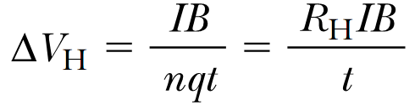
Using that A=td – cross sectional area of the conductor,
t – thickness of the conductor we can obtain:
R_{H} is the Hall coefficient:
R_{H} = 1/(nq)

Slide 28
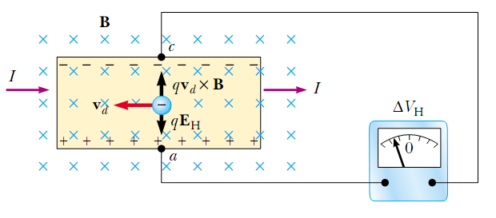
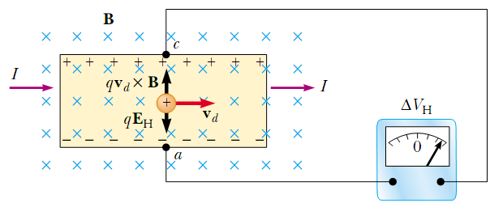
When the charge carriers in a Hall-effect apparatus are negative, the upper edge of the conductor becomes negatively charged, and c is at a lower electric potential than a.
When the charge carriers are positive, the upper edge becomes positively charged, and c is at a higher potential than a.

Slide 29
Units in Si
Magnetic field B T= N*s/(C*m)
T= N/(A*m)
Electric Field E V/m=N/C
Number density n 1/m³
Torque τ N*m

